Slide 1
Nonparametric Test for comparing Two populations: Independent Sample
1. Tests Two Independent Population Probability Distributions
2. Corresponds to t-Test for 2 Independent Means
3. Assumptions
Independent, Random Samples
Populations Are Continuous (Note no assumption about distribution)
4. Can Use Normal Approximation If n_{i} ≥ 10

Slide 2
Wilcoxon Rank Sum Test
Procedure
1. Assign Ranks, R_{i}, to the n₁ + n₂ Sample Observations
If Unequal Sample Sizes, Let n₁ Refer to Smaller-Sized Sample
Smallest Value = 1
2. Sum the Ranks, T_{i}, for Each Sample
Test Statistic Is T_{A} (Smallest Sample)
Null hypothesis: both samples come from the same underlying distribution
Distribution of T is not quite as simple as binomial, but it can be computed

Slide 3
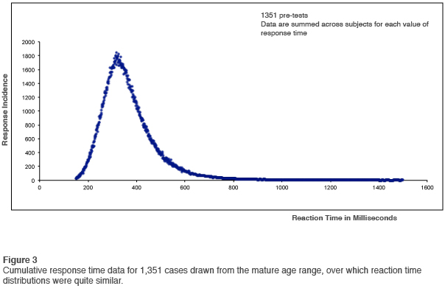
Example of the experiment to compare reaction time for adult males under influence of drug A with reaction time under influence of drug B.
t-test should not be used because normality assumption is not valid
Typical probability distribution of reaction time

Slide 4
Example of the experiment to compare reaction time for adult males under influence of drug A with reaction time under influence of drug B.
t-test should not be used because normality assumption is not valid
Drug A |  | Drug B
1.96 |  | 2.11
2.24 |  | 2.43
1.71 |  | 2.07
2.41 |  | 2.71
1.62 |  | 2.5
1.93 |  | 2.84
 |  | 2.88
Rank
Rank
4
6
7
9
2
5
8
11
1
10
3
12
13
25
66
Total Ranks

Slide 5
Wilcoxon Rank Sum Test
Solution
H0: Identical Distrib.
Ha: Shifted Left or Right
α = .10
n1 = 6 n2 = 7
Critical Value(s):
Test Statistic:
T1 = 4+7+ 2 + 8+ 1+3 = 25 (Smallest Sample)
Rejection Region: Since test is two sided, we will reject H₀ for T₁ ≤T_{l} or T₁≥ T_{u}. (T₁ ≤28 or T₁≥ 56).
Conclusion: Reject Ho
Do Not Reject
Reject
Reject
28
56
Σ Ranks

Slide 6
Critical values of T_{L} and T_{U} for the Wilcoxon Rank Sum Test: Independent samples
a. Alpha = 0.025 one-tailed; alpha = 0.05 two-tailed
 | n₁ | 3 |  | 4 |  | 5 |  | 6 |  | 7 |  | 8 |  | 9 |  | 10
n₂
 |  | T_{L} | T_{U} | T_{L} | T_{U} | T_{L} | T_{U} | T_{L} | T_{U} | T_{L} | T_{U} | T_{L} | T_{U} | T_{L} | T_{U} | T_{L} | T_{U}
3 |  | 5 | 16 | 6 | 18 | 6 | 21 | 7 | 23 | 7 | 26 | 8 | 28 | 8 | 31 | 9 | 33
4 |  | 6 | 18 | 11 | 25 | 12 | 28 | 12 | 32 | 13 | 35 | 14 | 38 | 15 | 41 | 16 | 44
5 |  | 6 | 21 | 12 | 28 | 18 | 37 | 19 | 41 | 20 | 45 | 21 | 49 | 22 | 53 | 24 | 56
6 |  | 7 | 23 | 12 | 32 | 19 | 41 | 26 | 52 | 28 | 56 | 29 | 61 | 31 | 65 | 32 | 70
7 |  | 7 | 26 | 13 | 35 | 20 | 45 | 28 | 56 | 37 | 68 | 39 | 73 | 41 | 78 | 43 | 83
8 |  | 8 | 28 | 14 | 38 | 21 | 49 | 29 | 61 | 39 | 73 | 49 | 87 | 51 | 93 | 54 | 98
9 |  | 8 | 31 | 15 | 41 | 22 | 53 | 31 | 65 | 41 | 78 | 51 | 93 | 63 | 108 | 66 | 114
10 |  | 9 | 33 | 16 | 44 | 24 | 56 | 32 | 70 | 43 | 83 | 54 | 98 | 66 | 114 | 79 | 131

Slide 7
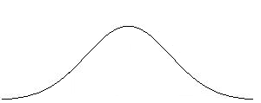
Distribution A
Note that distribution B is shifted to the right of distribution A
μ
X
Distribution B
μ
X

Slide 8
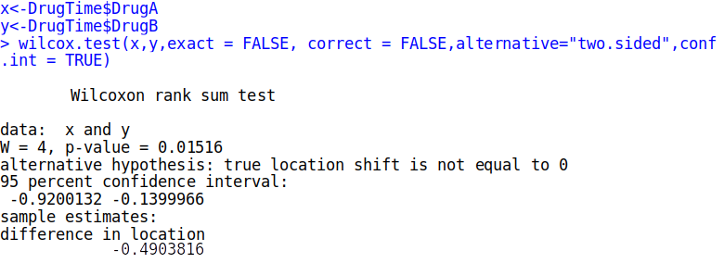
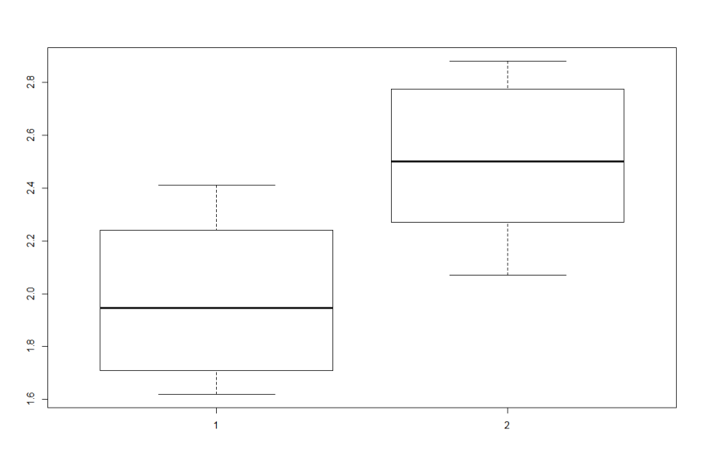
boxplot(DrugTime$DrugA,DrugTime$DrugB)

Slide 9
Small samples, independent groups
Wilcoxon Rank Sum Test
  first, combine the two samples and rank order all the observations.
  smallest number has rank 1, largest number has rank N (= sum of n₁ and n₂).
  separate samples and add up the ranks for the smaller sample. (If n₁ = n₂, choose either one.)
  test statistic : rank sum T for smaller sample.

Slide 10
Small samples, independent groups
Wilcoxon – One-tailed Hypotheses
H₀: Prob. distributions for 2 sampled populations are identical.
H_{A}: Prob. distribution for Population A shifted to right of distribution for Population B. (Note: could be to the left, but must be one or the other, not both.)

Slide 11
Small samples, independent groups
Wilcoxon – Two-tailed Hypotheses
H₀: Prob. distributions for 2 sampled populations are identical.
H_{A}: Prob. distribution for Population A shifted to right or left of distribution for Population B.

Slide 12
Small samples, independent groups
By design Rank sum T₁+T₂=n*(n+1)/2, where T₁- rank sum of sample 1 and T₂ rank sum of sample 2 (order doesn’t matter) thus small value of T₁ implyes larger value of T₂ (and vice versa)
Wilcoxon – Rejection region:
(With Sample taken from Population A being smaller than sample for Population B) – reject H₀ if
T_{A} ≥ T_{U} or T_{A} ≤ T_{L}

Slide 13
Wilcoxon Rank Sum Test:
Independent Sample
Let D₁ and D₂ represent the probability distributions for populations 1 and 2
One-Tailed Test
Two-Tailed Test
H₀ : D₁ = D₂
H_{a} : D₁ shifted right of D₂
[or D₁ shifted left of D₂ ]
Test Statistic:
T₁ if n₁<n₂, T₂ if n₁>n₂ (either rank sum if n₁=n₂)
Rejection Region:
T₁ : T₁≥T_{u}, [ orT₂ ≤ T_{L}]
T₂ : T₂≤T_{L}, [ orT₁ ≥ T_{U}]
H₀ : D₁ = D₂
H_{a} : D₁ shifted either right of or left of D₂
Test Statistic:
T=T₁ if n₁<n₂, T=T₂ if n₁>n₂ (either rank sum if n₁=n₂)
Rejection Region:
T≤T_{L}, or T ≥ T_{U}
.The test statistic for this test is rank sum from a smaller sample. Ties: Tied measurement assign the average of ranks

Slide 14

The Wilcoxon for Large Sample
T₁ can be approximate by normal distribution with mean
E()=
And variance

Slide 15

Large Sample Wilcoxon Rank Sum Test:
Independent Sample
Let D₁ and D₂ represent the probability distributions for populations 1 and 2
One-Tailed Test
Two-Tailed Test
H₀ : D₁ = D₂
H_{a} : D₁ shifted right of D₂
[or D₁ shifted left of D₂ ]
Rejection Region: z > z_{α}
(or z <z_{α} )
Only when n1 and n2 large enough
H₀ : D₁ = D₂
H_{a} : D₁ shifted either right of or left of D₂
Rejection Region:
| z | > z_{α/2}

Slide 16
Analysis of Messy Measurement Data
Standard procedures are ‘robust’ with respect to normality – perform well even when data are not normal
Problem – what to do when data are very far from normally distributed?

Slide 17
Analysis of Messy Measurement Data
Two common problems
  Outliers, a few subjects with extreme values
  Highly skewed data

Slide 18
SGA study:
Do small-for-gestational age infants differ from controls on glucose, lactate levels?
Is there a correlation between glucose and lactate levels?
Study ID | SGA Status | Glucose | Lactate
1 2 3 4 5 | 0 0 0 0 0 | 66 57 52 47 64 | 3.18 2.52 1.40 2.26 1.61
6 7 8 9 10 11 12 13 14 15 16 | 1 1 1 1 1 1 1 1 1 1 1 | 53 58 62 47 48 31 3 41 30 37 28 | 5.79 4.60 4.20 1.65 2.38 5.67 12.60 3.40 7.57 2.48 4.36
SGA small for gestational age infants.

Slide 19
Study ID | SGA Status | Glucose | Lactate | Rank | Sum
1 | 0 | 66 | 3.18 | 16
2 | 0 | 57 | 2.52 | 12
3 | 0 | 52 | 1.4 | 10
4 | 0 | 47 | 2.26 | 7.5
5 | 0 | 64 | 1.61 | 15 | 60.5
6 | 1 | 53 | 5.79 | 11
7 | 1 | 58 | 4.6 | 13
8 | 1 | 62 | 4.2 | 14
9 | 1 | 47 | 1.65 | 7.5
10 | 1 | 48 | 2.38 | 9
11 | 1 | 31 | 5.67 | 4
12 | 1 | 3 | 12.6 | 1
13 | 1 | 41 | 3.4 | 6
14 | 1 | 30 | 7.57 | 3
15 | 1 | 37 | 2.48 | 5
16 | 1 | 28 | 4.36 | 2 | 75.5

Slide 20
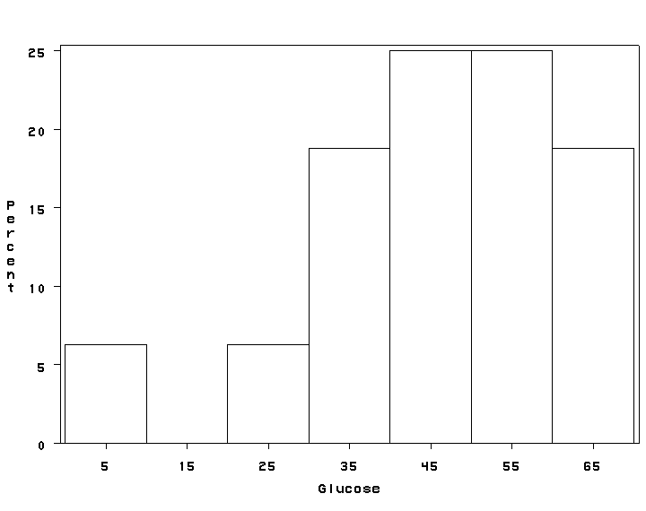
Outliers?

Slide 21
Glucose
Lactate

Slide 22
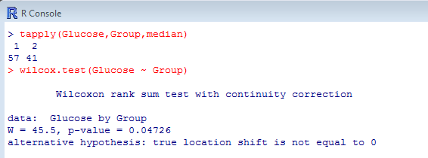
Wilcoxon Rank Sum test in R

Slide 23
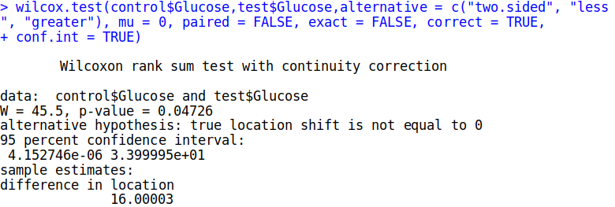
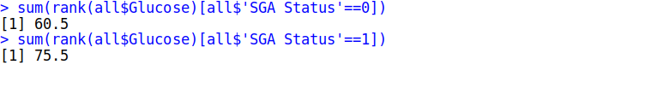
This returns a “difference in location” measure of 16. The documentation for the wilcox.test function states this “does not estimate the difference in medians (a common misconception) but rather the median of the difference between a sample from x and a sample from y.”
Now we run the Wilcoxon Rank Sum Test using the wilcox.test function. Again, the null is that the distributions are the same, and hence have the same median. The alternative is two-sided. We have no idea if one distribution is shifted to the left or right of the other.
First we notice the p-value is a little less than 0.05. Based on this result we may conclude the medians of these two distributions differ. The alternative hypothesis is stated as the “true location shift is not equal to 0”. That’s another way of saying “the distribution of one population is shifted to the left or right of the other,” which implies different medians.
The Wilcoxon statistic is returned as W = 45.5. This is NOT an estimate of the difference in medians. This is actually the number of times that a value from group 0 is less than in group 1.

Slide 24
 | SGA (n=11*) | Controls (n=5) | p-value
t-test on full sample | 39.8 + 16.7 | 57.2 + 8.0 | .047
t-test excluding outlier | 43.5 + 12.0 | 57.2 + 8.0 | .040
Rank sum test (median) | 41 | 57 | .047
In many situations, different approaches give similar results

Slide 25
Example: Association between adherence to medical visits and control of HIV disease
Do patients with better adherence have better control (lower viral load, higher CD4) than those with poor adherence?
Study ID | HIV RNA | CD4 | # Appoints | # Visits | Adherence
1 2 3 4 5 6 7 8 9 10 | 55498 500000 500000 33216 1609 13993 92596 50135 47947 3105 | 319 514 71 83 328 343 8 7 26 453 | 13 11 14 13 10 15 8 22 30 15 | 10 10 9 9 7 13 3 22 21 15 | 76.9% 90.9 64.6 69.2 70.0 86.7 37.5 100.0 70.0 100.0

Slide 26
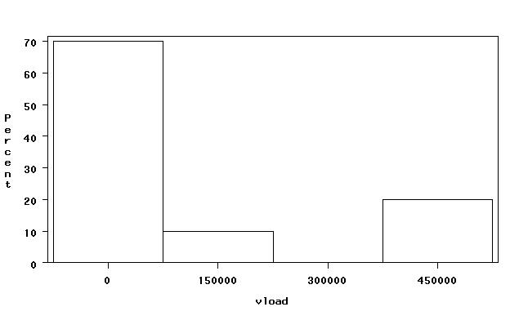

Slide 27
Analysis of Messy Measurement Data
Highly skewed distribution
  transform the variable (log, square root)
  Categorize the variable
  non-parametric procedures

Slide 28
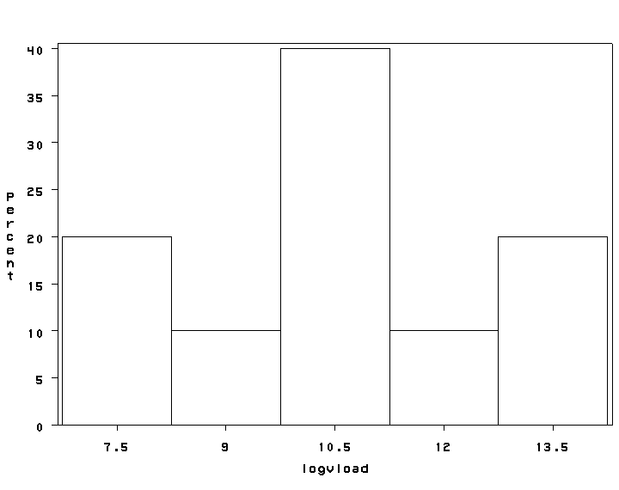
Natural log transformation for skewed data

Slide 29
Categorizing Messy Measurement Data
Viral Load | %
0 – 50,000 50,000 – 100,000 100,000+ | 50% 30% 20%

Slide 30
Median (range) blood loss under hypotensive and normotensive anaesthesia
 | Normotensive group (n=29) | Hypotensive group (n=24) | p-value
Total BL | 350 (130 – 1575) | 200 (90 – 400) | 0.01

Slide 31
White blood cell count for patients with West Nile disease in Illinois
n mean sd range median interquartile range | 473 144.1 231.9 0 -- 1,753 63 23 -- 168

Slide 32
Analysis of Messy Measurement Data
Parametric
Procedure
  independent sample
t-test
  paired sample
t-test
  Pearson’s
correlation
Non-Parametric
Procedure
  Wilcoxon rank sum
test
  Wilcoxon signed rank
test
  Spearman’s
correlation

Slide 33
Transform data or use non-parmetric methods?
Non-parametric methods
  Advantages: simple, intuitive procedures; clearly address the concerns; appropriate with small sample size
  Disadvantage: difficult to do adjusted, multivariable analyses
Transform the data
  Advantages: allows full menu of adjusted, multivariable analyses
  Disadvantages: transformed data hard to interpret; may not address the concerns

Slide 34
Analysis of Messy Measurement Data
Wilcoxon rank sum test (independent samples)
  rank the values from the two samples from smallest to largest
  test statistic: sum of the ranks from the smaller sample
  reject the null (no difference in medians) if the sum of the ranks is either very large or very small

Slide 35
Time (days) between episodes of disease
Endogenous Depression | Neurotic Depression
109 214 179 744 105 101 104 1547 529 140 | 546 844 794 643 199 91 103 479 1296 279
Median 160 | Median 513
Is there a statistical difference?

Slide 36
Patients with endogenous depression |  | Patients with neurotic depression
109 214 179 744 105 101 104 1547 529 140 median 160 | (6) (10) (8) (16) (5) (2) (4) (20) (13) (7) | 546 844 794 643 199 91 103 479 1296 279 median 513 | (14) (18) (17) (15) (9) (1) (3) (12) (19) (11)
W = Sum of the ranks (of the smaller sample) = 91

Slide 37
Critical values of T_{L} and T_{U} for the Wilcoxon Rank Sum Test: Independent samples
a. Alpha = 0.025 one-tailed; alpha = 0.05 two-tailed
 | n₁ | 3 |  | 4 |  | 5 |  | 6 |  | 7 |  | 8 |  | 9 |  | 10
n₂
 |  | T_{L} | T_{U} | T_{L} | T_{U} | T_{L} | T_{U} | T_{L} | T_{U} | T_{L} | T_{U} | T_{L} | T_{U} | T_{L} | T_{U} | T_{L} | T_{U}
3 |  | 5 | 16 | 6 | 18 | 6 | 21 | 7 | 23 | 7 | 26 | 8 | 28 | 8 | 31 | 9 | 33
4 |  | 6 | 18 | 11 | 25 | 12 | 28 | 12 | 32 | 13 | 35 | 14 | 38 | 15 | 41 | 16 | 44
5 |  | 6 | 21 | 12 | 28 | 18 | 37 | 19 | 41 | 20 | 45 | 21 | 49 | 22 | 53 | 24 | 56
6 |  | 7 | 23 | 12 | 32 | 19 | 41 | 26 | 52 | 28 | 56 | 29 | 61 | 31 | 65 | 32 | 70
7 |  | 7 | 26 | 13 | 35 | 20 | 45 | 28 | 56 | 37 | 68 | 39 | 73 | 41 | 78 | 43 | 83
8 |  | 8 | 28 | 14 | 38 | 21 | 49 | 29 | 61 | 39 | 73 | 49 | 87 | 51 | 93 | 54 | 98
9 |  | 8 | 31 | 15 | 41 | 22 | 53 | 31 | 65 | 41 | 78 | 51 | 93 | 63 | 108 | 66 | 114
10 |  | 9 | 33 | 16 | 44 | 24 | 56 | 32 | 70 | 43 | 83 | 54 | 98 | 66 | 114 | 79 | 131

Slide 38
Time to recurrence study
The sum of the ranks (W=91) is between the lower and upper rejection values for the rank sum test (79 , 131), and so we fail to reject the null hypothesis.
There was no significant difference in the median time to between disease episodes for patients with endogenous (median time 160 days) and neurotic (median time 513 days) depression.

Slide 39
